Slide 1






THE POS SYSTEM
APPLICATION DEV USING C#.NET
ITE-5230-IRA
DVD GROUP
VY LY - N01600569
DARIYA TAKENOVA- N01633069
DARSHAN CHETANKUMAR GANDHI –N01619143

Slide 2



INTRODUCTION
Our POS (Point of Sale) system for restaurants is designed to streamline the operations of your establishment, enhancing efficiency and customer satisfaction. With intuitive interfaces for both attendants/cashiers and administrators, this Windows application empowers your staff to manage tables, process orders, and handle payments seamlessly.
Your Catchy Headline Here

Slide 3


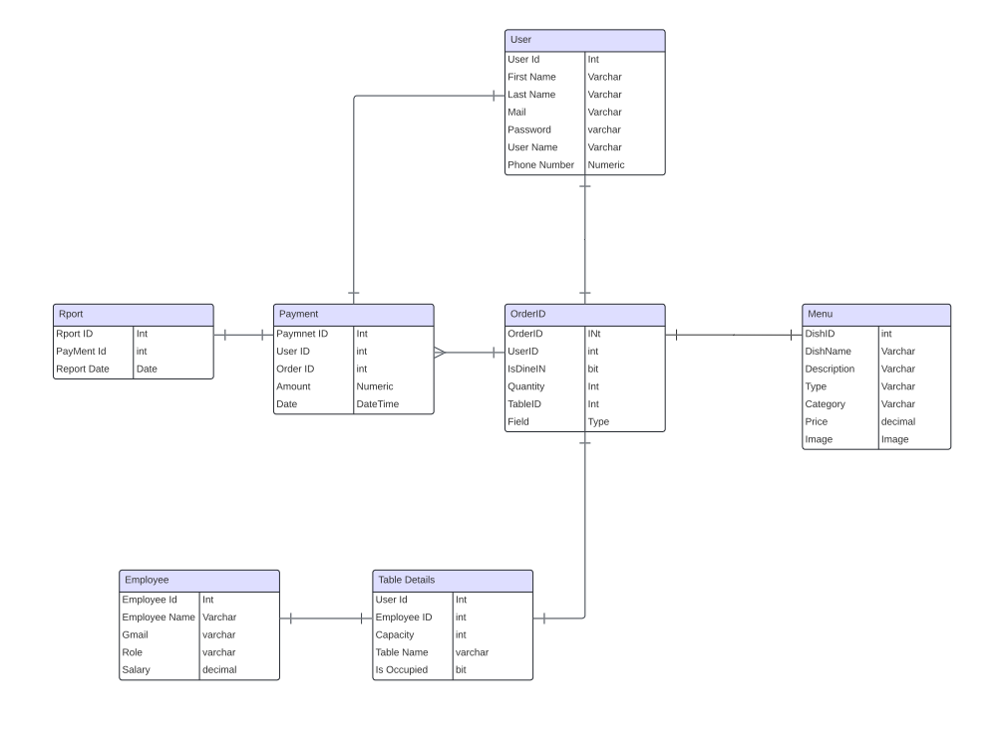
DATA
DIAGRAM

Slide 4

FUNCTIONALITY
LOGIN VIEW
Both attendants and administrators access the system through a login page, with views tailored to their respective roles.
SIGNUP VIEW
Customers can easily create their accounts by providing necessary details such as name, email, and contact information

Slide 5


FEATURES: ADMIN VIEW
Menu Management
Add, edit, or delete menu items.
Organize items into categories.
Enable/disable items for special occasions or out-of-stock situations.
Table Management
View and manage table status (occupied, available, reserved).
Employee Management
Add, edit, or remove employee profiles.
Reports and Analytics
Generate sales reports (daily, weekly, monthly).

Slide 6




FEATURES: CUSTOMER VIEW
Menu Items:
Displays available food and drinks organized into categories.
Subcategories include appetizers, beverages, soups, desserts, etc.
Cart Management
Display items, display table, display total cost
Ability to print the bill and mark payment status.
Payment Options
Visa, Mastercard, cash, debit payment options available.

Slide 7




Thank you
FOR LISTENING!
DEMO

